Slide 1
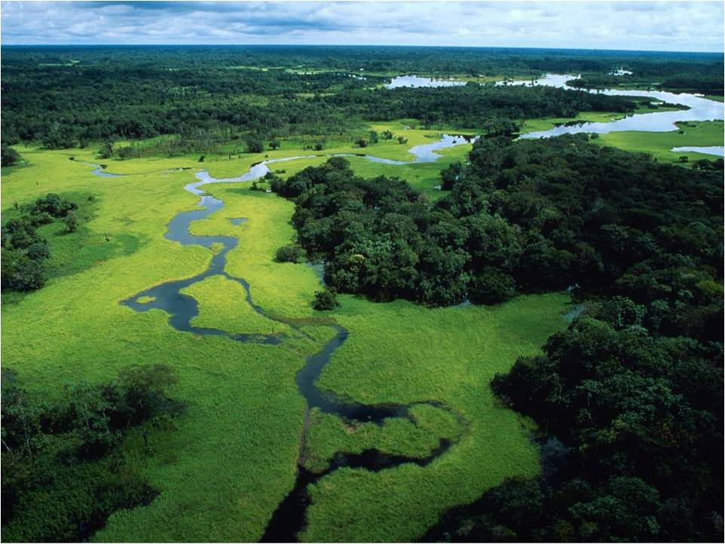
Response to the European Commission public consultation on a 2030 climate and energy package
2nd July 2012
WWF European Policy Office, 168 Avenue de Tervuren, Brussels
EU Transparency Register Nr: 1414929419-24
© Michel Roggo / WWF-Canon
Details of the supporting evidence for this submission can be found on pages 18 to 20

Slide 2
The EU faces meaningful choice for 2030
Europe has been at the forefront of concern about climate change and the transition to sustainable energy. But much has changed since the current legislative package was agreed. Now nearly 100 countries in the world have significant climate policies, and 138 countries in the world have defined renewable energy targets. South Korea has the fastest growing clean manufacturing industry and South Africa spent a higher proportion of GDP last year on renewables than any other country. This is not the world of yesterday - it is the world of tomorrow beginning to take shape, and Europe is struggling to find its place within it.
At the same time, it is more than ever apparent that the gap between current climate action and the reality of climate change is widening. Nowhere is this more apparent than in Europe. Current policy is failing to prevent increases in coal emissions. Overseas offset credits give the illusion of action, while delaying real change. Resistance to taking the necessary steps means the EU can increase its emissions over the coming seven years, while also negotiating a UN treaty to cut emissions.
Europeans care about climate change and support a sustainable energy transition. Understandably their chief day-to-day concerns are about meeting the necessities of life in a challenging economic environment. But it is only special interests that are making the case that these two goals are irreconcilable. In reality, those clean industries we need to fight climate change are offering solid growth potential. In reality, reducing energy use and freeing ourselves from fossil fuel import dependency will stabilise prices and reduce security of supply risks. In reality, measures to interconnect energy markets, make our buildings more efficient and decarbonise transport will provide new stimuli to jobs and manufacturing.
Europe's leaders face a choice: retreat and retrench to the past, seeking to milk the last drops from a pollution-based economy, or continue the path to the future, to an economy that is sustainable, meets people's needs, and will keep Europe globally relevant.

Slide 3
The essence of a 2030 framework
on climate & energy:
We must work to significantly reduce the risk of climate change by cutting emissions through the delivery of sustainable energy that is affordable enough to allow Europe's businesses and citizens to benefit from global competition.
Targets
Legally binding complementary targets on emissions reductions (-55%), energy savings (-40%), and renewable energy (45%) set at EU level and effort shared among Member States
+15%
Instruments
+15%
The EU Emissions Trading Scheme must be fixed to ensure it drives decarbonisation and the internal energy market completed in order to maximise EU wide potential of renewable energy and energy savings
Information descriptor
Can appear below
the numbers
Security of supply and competitiveness
Cannot only be considered through the prism of energy prices, but must focus on overall productivity by prioritising skills, research, and innovation. The development of the EU's energy system must also focus on the least risky decarbonisation options.
Effort Sharing
The current effort sharing framework must also be reformed to ensure all member states deliver domestic emissions reductions through energy savings and renewable energy.

Slide 4
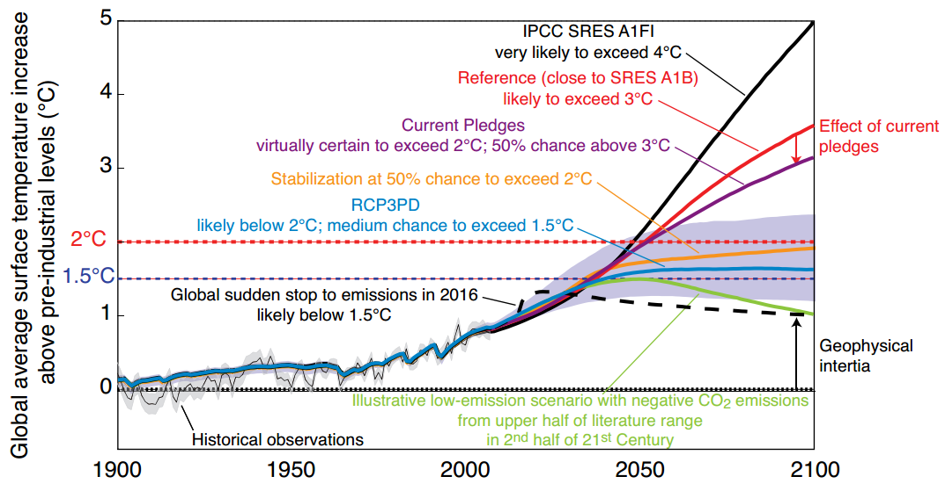
The need to tackle catastrophic climate
change cannot be delayed or negotiated away
On current governmental pledges, the world is virtually certain to exceed the two degree average temperature increase threshold that is associated with dangerous climate change and which those same governments have committed to avoid.
Unless further action is taken, there will be enormous consequences of a warmer world, including:
Fatal extreme heat waves will become the new normal summer, causing heat related deaths, forest fires, and harvest losses that could exceed the adaptive capacities of societies and natural systems.
The regional extinction of entire ecosystems, such as coral reefs, with profound consequences for dependent species and people who rely on them for food, income, tourism, and shoreline protection.
Severe disruptions, damage, and dislocation to populations, with the poor likely to suffer most - resulting in a more fractured and unequal global community, with corresponding consequences.
+15%
+15%
The EU must agree an emissions reduction target which makes an adequate contribution to preventing dangerous climate change based on the EU's capacity and potential to mitigate, reaching a high probability of staying below 2 degrees warming. The emphasis should be on domestic emissions, with additional reduction effort supported abroad under a fully reformed approach that no longer functions as a supply of 'offsets'.
Information descriptor
Can appear below
the numbers

Slide 5
Climate and energy policy addresses present and future needs
European citizens' greatest immediate concerns are about jobs, stable economies, and health security. They are also deeply concerned about climate change.
European decision takers agree they want growth that is smart (through more effective investments in education, research, and innovation), sustainable (through the move to a low carbon economy, and inclusive (through job creation and poverty reduction).
Both agree they want an economy that sustains a healthy environment and vice versa: meeting both future and present needs.
+15%
+15%
Information descriptor
Can appear below
the numbers

Slide 6
Climate & energy policy is already delivering, and can do much more with 2030 policies
JOBS:
  People directly or indirectly employed in the EU renewable energy sector grew 30% 2009-11 as overall EU employment rates fell.
  Ambitious 2030 renewable energy targets could result in 4.4 million jobs in the EU.
  Investing a million Euros in energy efficiency in buildings alone can create on average 19 direct jobs, compared to less than 5 direct jobs in coal or nuclear plants.
STABLE ECONOMIES:
  Climate change policies can reduce the impact (loss of GDP) of an energy price shock by half, and the costs to the European economy of oil price rises are lower when climate and energy policies are enacted.
  Even during the on going global economic crisis, the global cleantech market almost doubled - from €104bn in 2008 to €198bn in 2011. This shift is happening worldwide, and the EU needs to keep up.
  Now is the time to push low-carbon investment because the long economic slowdown means resource costs and the risk of crowding out alternative investment and employment is are low.
ENVIRONMENT AND HEALTH:
  Air pollution from the 10,000 largest polluting facilities in Europe cost citizens between €102bn and €169bn in 2009 alone.
  The heat-waves which caused tens of thousands of premature deaths over the last decade are very likely to increase, as are the health risks of flooding due to increases in extreme rainfall.
  Renovating existing buildings can deliver quantifiable EU wide health benefits worth €64 to €140 bn annually in 2020, including through reduced public health spending and fewer missed days of work.
.
+15%
+15%
Information descriptor
Can appear below
the numbers

Slide 7
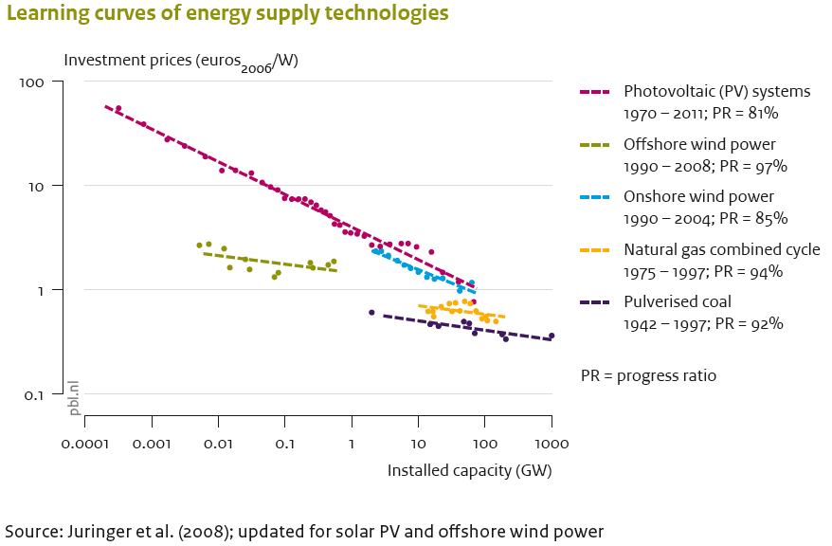
The EU needs to maintain momentum on renewables and efficiency to reap benefits
As the early investor and first mover on renewable energy and energy efficiency, the EU has supported and continues to support the progression of a number of new technologies through the most expensive part of their cost curves. It has required significant public and political will to deliver the required policy and financial support.
Thanks to this European effort,
sustainable energy costs are
rapidly reducing and the EU is
also benefiting in terms of job
creation, environmental protection,
and health. However, unless the
EU continues to provide a stable
policy and support environment,
then it will be other countries
who maximise the benefits of
the EU's efforts by rolling out
these maturing technologies at
lower prices. This in turn will put
the EU at risk of losing out on
large parts of the renewable
energy and energy efficiency
value chain that have been
carefully built up within the
Union.
+15%
+15%
Information descriptor
Can appear below
the numbers

Slide 8
EC scenarios are among the least ambitious recent 2030 decarbonisation studies
European Commission, Energy Roadmap 2050:
  High RES scenario = 26% energy savings and 31% renewable energy
  High Efficiency scenario = 29% energy savings and 28% renewable energy
Greenpeace, Energy [R]evolution (EU):
  = 29% energy savings, 42% renewable energy, 55% emissions reductions
EREC, 45% by 2030:
  Baseline scenario = 42% renewable energy
  Advanced scenario = 48% renewable energy
Fraunhofer, Contribution of Energy Efficiency Measures to Climate Protection:
  = 51% Energy savings
WWF, Re-Energising Europe 2030 study:
  = 38% energy savings, 41% renewable energy, 50% emissions reductions
+15%
+15%
Information descriptor
Can appear below
the numbers
Each of these scenario studies start from a different normative position, such as the need to reduce overall emissions by a given level. WWF's own starting goal is the delivery of 100% renewable energy, globally, by 2050. Furthermore, each of these reports make different assumptions about key aspects of energy sector decarbonisation, such as future energy prices, the learning curves of different technologies, and the sustainable level of energy generation from different sources. Following a close examination of all of the studies above, as well as information from other sources such as our carbon budget analysis of the EU's fair share of an equitable GHG reduction effort, WWF believes that the targets detailed below should be adopted by the European Union for 2030.

Slide 9
Targets based on achievable potentials are needed to meet Europe's present and future needs
Energy Efficiency
At least 40% less energy use than in 2005
Renewable Energy
At least 45% of renewables in the energy mix
CO2 reductions
At least 55% cuts in domestic CO2 compared to 1990
Europe facilitates its decarbonisation path by reducing the amount of energy produced and used from all sources, and the infrastructure needed to deliver it - significantly reducing costs, as well as generating jobs and cutting pollution.
Europe maximises its most reliable and least risky decarbonising energy sources and benefits from early investments that continue reduce costs - in contrast to unproven CCS and increasingly expensive nuclear power.
Europe delivers CO2 cuts in line with its responsibility and capability to mitigate.
-55% in 2030 continues the current reduction rate of 2% a year, which reaches -95% in 2050. To be implemented with an initial 2025 target, aligned with a UN approach, subject to revision for 2030.
+15%
+15%
Information descriptor
Can appear below
the numbers
Facilitates delivery of
Helps deliver
Helps deliver

Slide 10
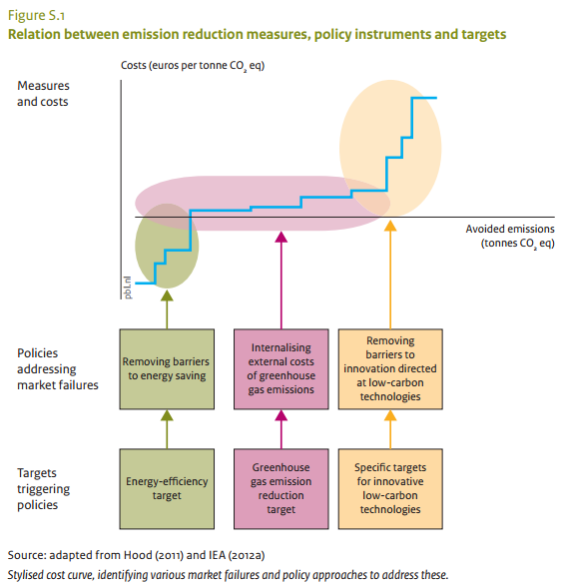
Three binding targets work - together
Three targets are required because:
Alone, an extremely high carbon price would be needed to make new low carbon technologies viable without additional support.
Alone, a carbon price will not boost energy efficiency measures, which are blocked by non-economic barriers.
Alone, a carbon price without complementary economic and policy support for savings and renewables is not the most economically efficient solution.
+15%
+15%
Information descriptor
Can appear below
the numbers
The European Commission should outline an effective and efficient suite of policies using three targets. This starts by modelling their interaction to be able to set targets appropriately.

Slide 11
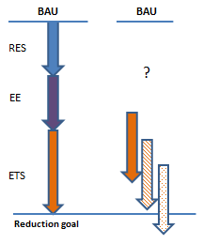
Targets should be set at EU level
A GHG target divided into ETS and effort sharing sectors, supported by RE and EE targets, as well as the full range of other measures, requires an EU approach to remain coherent.
An ETS system can only function correctly if it takes into account related actions to increase renewable energy and energy efficiency, because these have a direct influence on the supply and demand balance in the system. Unless renewable energy and energy efficiency targets are set at EU level the EU ETS will not be able to take into account the disparate, un-coordinated efforts of individual member states and will not be able to function properly - inevitably creating a price that is suboptimal.
+15%
+15%
Information descriptor
Can appear below
the numbers
The European Commission should propose to model, agree and implement a suite of targets together to ensure proper interaction. It is also essential to limit offsets and set an adequate reduction goal, to avoid the current situation where the EU is 'overachieving' while not in fact making sufficient effort to play its part in fighting climate change.

Slide 12
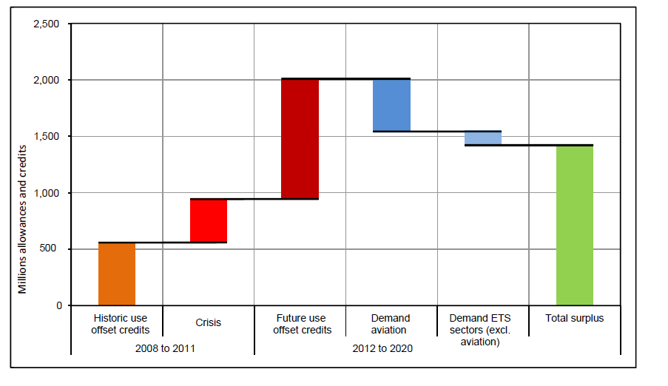
The EU Emissions Trading Scheme
must be made to work
The EU ETS is failing. Today,
there is insufficient scarcity
of emission allowances in
the system, which means the
intended price pressure on
pollution does not exist. This
pressure will only come if there
is a sufficiently stringent
emissions reduction target
that will provide confidence in
an effective carbon price to
drive long term emission
reductions regardless of
unpredictable changes in the
macroeconomic cycle. This
stringency can be achieved, in
part, by the restricting
emissions offsets, which
have created more than 2/3 of the surplus allowances that depress the EU ETS price. The combination with the effect of the economic downturn justifies a permanent cancellation of the surplus allowances.
+15%
+15%
Information descriptor
Can appear below
the numbers
The EU ETS must become an effective tool for guiding investment and business decisions towards options that will comply with overall emissions reductions targets. To achieve this, both the short-term fix of the cancellation of surplus allowances and structural reform to increase the linear reduction factor are required.

Slide 13
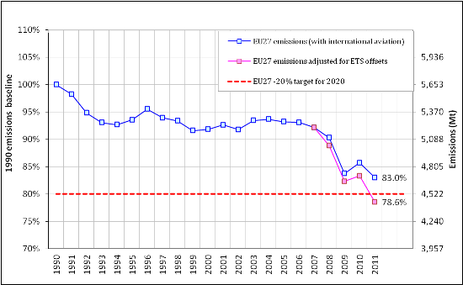
The EU Effort Sharing Directive
is in equal need of reform
Just as the credibility of the EU ETS is under threat from the abundance of surplus credits, so the mechanism for cutting emissions from the non-ETS half of the economy is also being undermined. The Effort Sharing Directive includes such extensive flexibilities that there is very little pressure on Member States to deliver emissions reductions within their own borders. Indeed, recent analysis of Europe's progress towards the 20% emissions reduction by 2020 target shows that it is already being exceeded because of the use of offsets (see graph - Sandbag) - meaning that the EU could increase emissions from now until 2020.
The Effort Sharing Directive must be reformed in order to ensure it drives emissions cuts in Europe
+15%
+15%
This would benefit the EU by:
ensuring each Member State has a legally binding economy wide emissions reduction target
potentially reducing the cost of cutting emissions
ensuring fair distribution of action and solidarity, especially when compared to indicative targets with no allocated responsibilities
Information descriptor
Can appear below
the numbers
linking differential capabilities to available financing to help meeting the targets
allowing for national analysis that shows the benefits of achieving effort shared targets
helping to improve policy coordination on energy savings and renewables

Slide 14
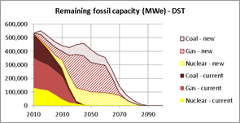
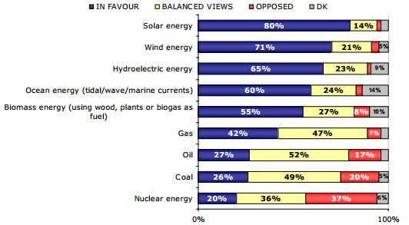
The EU's choices must minimise delivery risk
+15%
+15%
All of the European Commission's Energy Roadmap 2050 decarbonisation scenarios envisage between 400 & 500 gigawatts of electricity from nuclear and fossil fuels in 2030, including through the delivery of new coal, gas, and nuclear power (graph shows development in Diversified Supply Technologies scenario). This implies significant reliance on the delivery of carbon capture and storage technologies and new nuclear power to meet decarbonisation goals. The possibility that CCS will not become commercially available, that new nuclear is prohibitively expensive, or that both meet with significant public resistance (the 2012 Eurobarometer energy survey indicates the strong support for renewables compared to fossil fuels or nuclear) cannot be ignored. The impact of failing to deliver on CCS or nuclear would either be unacceptable emissions, a shortfall in capacity, or an expensive rush to scale up renewable power after years of relative under-investment. However, the ETS alone may not be able to remove some of the dirtiest power plants from the grid, since these can also be the cheapest to build and operate.
Information descriptor
Can appear below
the numbers
The Commission must examine the potential of proven renewable energy and energy efficiency technologies with a new scenario that maximises both together at levels shown to be possible and sustainable in recent reports from WWF, Greenpeace, Fraunhofer, and EREC. Secondly, the EC should propose a facility-level Emissions Performance Standard to prevent lock-in of emitting sources.

Slide 15
Competitiveness is not all about energy prices; specific industries require targeted solutions
Some energy intensive industries argue that lower energy prices in North America justify slowing down climate and energy policy in the EU overall. This is the wrong response.
Energy is only one input to industry, and maximising 'total factor productivity' through innovation and improvement in processes, techniques, and technologies is where most economic growth stems from in well-developed economies. KfW found recently that 'in spite of differentials in national energy prices that cannot be neglected, much seems to indicate that there should be no long-term competitive advantages or disadvantages for the economy as a whole'. As only specific industries have particular needs the approach should be targeted, not pulling down effort as a whole.
Furthermore, the apparent 'solution' some advocate for high energy prices seems to be for EU energy policy to either facilitate greater access to fossil fuels, or at least to limit investment in renewable energy and energy efficiency. This is ill-conceived. EU shale gas reserves remain unproven and unpopular, and there is no clarity on the potential price of this resource were it able to be exploited within Europe. Diverting Europe into a fossil fuel sideshow will expose us to more rather than less price volatility. Last, but obviously in no way least, we must must leave most fossil fuels in the ground to have any chance of avoiding dangerous global warming.
North America may be seeing increased investment in fossil-fuel reliant industry, but it is coming just as the end of the shale gas boom is in sight and climate restrictions begin to be contemplated. They are likely heading for an unpleasant wake-up call when the effect of delaying investment in decarbonisation becomes clear. Europe has different resources and a different path, with its own advantages. It should stay focused.
Industries genuinely at risk due to policy should be carefully identified through detailed analysis, and supported with targeted measures. The focus should be on improvements in total factor productivity through skills development, research, and innovation in renewable energy and energy saving technologies. A portion of auctioning revenues from the fully reformed EU ETS should be centrally earmarked for this purpose.

Slide 16
Renewable energy & energy efficiency
improve security of supply in well-designed
and functioning markets
Europe's continued reliance on imported fossil fuels drives hundreds of billions of euros out of the Union every year, increases EU economies' exposure to unpredictable and damaging price shocks, and adds to Europe's environmental and health costs. This situation is not inevitable - it simply reflects the current setup of Europe's energy markets. By contrast, an economic context prioritising renewable energy and energy efficiency would improve the security of Europe's energy supplies by increasing the Union's ability to manage its energy sources. For example, in 2010 wind power generation alone displaced €5.71bn worth of fuel costs.
It is essential, therefore, that in completing its internal energy market, the EU builds a system that facilitates the full integration of energy savings and renewable energy, rather than favouring the needs of incumbent fossil fuel burning power generators.
For example, any capacity market mechanism which principally rewards gas and coal plants for being 'on-standby' would be counter productive. Instead, Europe needs integrated markets that match variable supply by prioritising flexible demand through long term demand reduction, targeted support for demand side response measures, electricity storage, increased decentralisation of power generation and greater regional grid interconnections that do not compromise habitat protection.
A completed internal energy market is an essential part of the progress towards updating Europe's energy systems to maximise the benefits of renewable energy and energy savings across the Union, and this must be reflected in the forthcoming 2030 Framework of climate and energy policies.

Slide 17

WWF's Response to the European Commission public consultation on a 2030 climate and energy package
Three Binding targets
Make the Tools work
55% emissions reductions
45% renewable energy
40% energy efficiency
Reform the EU ETS and the effort sharing mechanism
Address problems head on
Cut the Risk
Implement an EPS to ensure avoiding fossil fuel lock-in
Use proven & deliverable technologies to reduce emissions
Photo: © Michel Roggo / WWF-Canon

Slide 18
Evidence supporting this submission (1 of 3)
Page 4:
  The Potsdam Institute for Climate Impact Research and Climate Analytics for The World Bank, Turn Down the Heat; Why a 4ºC warmer world must be avoided, 2012
Page 5:
  Eurobarometer 78, autumn 2012
  Special Eurobarometer 372, October 2011
  The Europe 2020 Growth Strategy
Page 6:
  Fraunhofer ISI et al., EmployRES; The impact of renewable energy policy on economic growth and employment in the European Union, 2009
  European Renewable Energy Council; 45% by 2030, Towards a truly sustainable energy system in the EU, 2011
  The Energy Efficiency Industrial Forum, How Many Jobs?; A survey of the employment effects of investment in energy efficiency of buildings, 2012
  Rio 2012 Issues Briefs, Green jobs and social inclusion, UNCSD Secretariat, 2011
  Oxford Economics for the UK Department of Energy and Climate Change, Fossil fuel price shocks and a low carbon economy, 2011
  Roland Berger for WWF, Clean Economy, Living Planet; The race to the top of global clean energy technology manufacturing, 2012
  The Grantham Research Institute on Climate Change and the Environment and the Centre for Climate Change Economics and Policy, A strategy for restoring confidence and economic growth through green investment and innovation, April 2012
  European Environment Agency, Revealing the costs of air pollution from industrial facilities in Europe, 2011
  European Environment Agency, Climate change, impacts and vulnerability in Europe, 2012
  Copenhagen Economics for Renovate Europe, Multiple benefits of investing in energy efficient renovation of buildings - impact on public finances, 2012

Slide 19
Evidence supporting this submission (2 of 3)
Page 7 & 10:
  ECOFYS, EU policy options for climate and energy beyond 2020, 2013
  ECOFYS, How to trigger low carbon technologies by EU targets for 2030?, An assessment of technology needs, 2013
Page 8:
  The European Commission, Energy Roadmap 2050, 2011
  Greenpeace, Energy [R]evolution; A sustainable EU 27 energy outlook, 2012
  European Renewable Energy Council, 45% by 2030; Towards a truly sustainable energy system in the EU, 2011
  Fraunhofer ISI, Contribution of Energy Efficiency Measures to Climate Protection within the European Union until 2050, 2012
  WWF, Re-Energising Europe; Putting the EU on track for 100% renewable energy, 2013
Page 11:
  International Energy Agency, Summing up the parts; combining policy instruments for least-cost climate mitigation strategies, 2011
Page 12:
  Climate Action Network Europe, Greenpeace, WWF, EU ETS at a crossroads; An NGO briefing, 2013
Page 13:
  Sandbag, Europe smashes weak 2020 climate target nine years early, 2013
Page 14:
  CE Delft for WWF, Re-Energising Europe; Cutting energy related emissions the right way, 2012
  Special Eurobarometer 372, October 2011

Slide 20
Evidence supporting this submission (3 of 3)
Page 15:
  KfW Economic Research, Fracking - you snooze, you lose?, 2013
  The Grantham Research Institute on Climate Change and the Environment and Carbon Tracker, Unburnable Carbon 2013; Wasted capital and stranded assets, 2013
Page 16:
  European Wind Energy Association, Green Growth; The impact of wind energy on jobs and the economy, 2012

